Slide 1
De Novo Genome Assembly - Introduction
Henrik Lantz - NBIS/SciLifeLab/Uppsala University

Slide 2
Schedule - de novo assembly course
Wednesday 15 November
09.00-09.15 Introduction (Henrik Lantz)
09.15-10.00 Lecture: NGS technologies and basic concepts (Henrik Lantz)
10.00-10.15 Coffee break
10.15-11.00 Lecture: Quality control and read trimming (Mahesh Binzer-Panchal)
11.00-12.00 Exercise: Quality control and read trimming (Mahesh Binzer-Panchal, Henrik Lantz, Jacques Dainat, Lucile Soler)
12.00-13.00 Lunch
13.00-14.00 Exercise: Quality control and read trimming contd.
14.00-14.30 Lecture: Kmer-analysis, contamination analysis, and mapping-based analysis (Mahesh Binzer-Panchal)
14.30-17.00 Exercise: Kmer-analysis, contamination analysis, and mapping-based analysis, incl. coffee break (Mahesh Binzer-Panchal, Henrik Lantz, Jacques Dainat, Lucile Soler)
All lectures and exercises in this room!

Slide 3
Schedule - de novo assembly course
Thursday 16 November
09.00-09.30 Discussion of last day’s exercises (Henrik Lantz, Mahesh Binzer-Panchal)
09.30-10.00 Lecture: Assembly basics - Genome properties (Henrik Lantz)
10.00-10.15 Coffee break
10.15-11.00 Lecture: Illumina assembly (Mahesh Binzer-Panchal)
11.00-12.00 Exercise: Illumina assembly (Mahesh Binzer-Panchal, Henrik Lantz, Jacques Dainat, Lucile Soler)
12.00-13.00 Lunch
13.00-13.30 Exercise: Illumina assembly contd.
13.30-14.30 Lecture: Long read assembly (Mahesh Binzer-Panchal)
14.30-17.00 Exercise: PacBio assembly, incl. coffee break (Mahesh Binzer-Panchal, Henrik Lantz, Jacques Dainat, Lucile Soler)

Slide 4
Schedule - de novo assembly course
Friday 17 November
09.00-09.30 Discussion of last day’s exercises (Mahesh Binzer-Panchal, Henrik Lantz)
09.30-10.15 Lecture: Assembly validation(Mahesh Binzer-Panchal)
10.15-10.30 Coffee break
10.30-12.00 Exercise: Assembly validation (Mahesh Binzer-Panchal, Henrik Lantz, Jacques Dainat, Lucile Soler)
12.00-13.00 Lunch
13.00-15.00 Team-based exercise (Mahesh Binzer-Panchal, Henrik Lantz, Jacques Dainat, Lucile Soler)
15.00-15.15 Coffee break
15.15-17.00 Exercise discussion and wrap-up (Mahesh Binzer-Panchal, Henrik Lantz)

Slide 5

Practical info
Coffee breaks
Lunch
Dinner at Meza
Grill & Bar,
Östra Ågatan 11

Slide 6
De Novo Genome Assembly - Assembly basics
Henrik Lantz - NBIS/SciLifeLab/Uppsala University

Slide 7
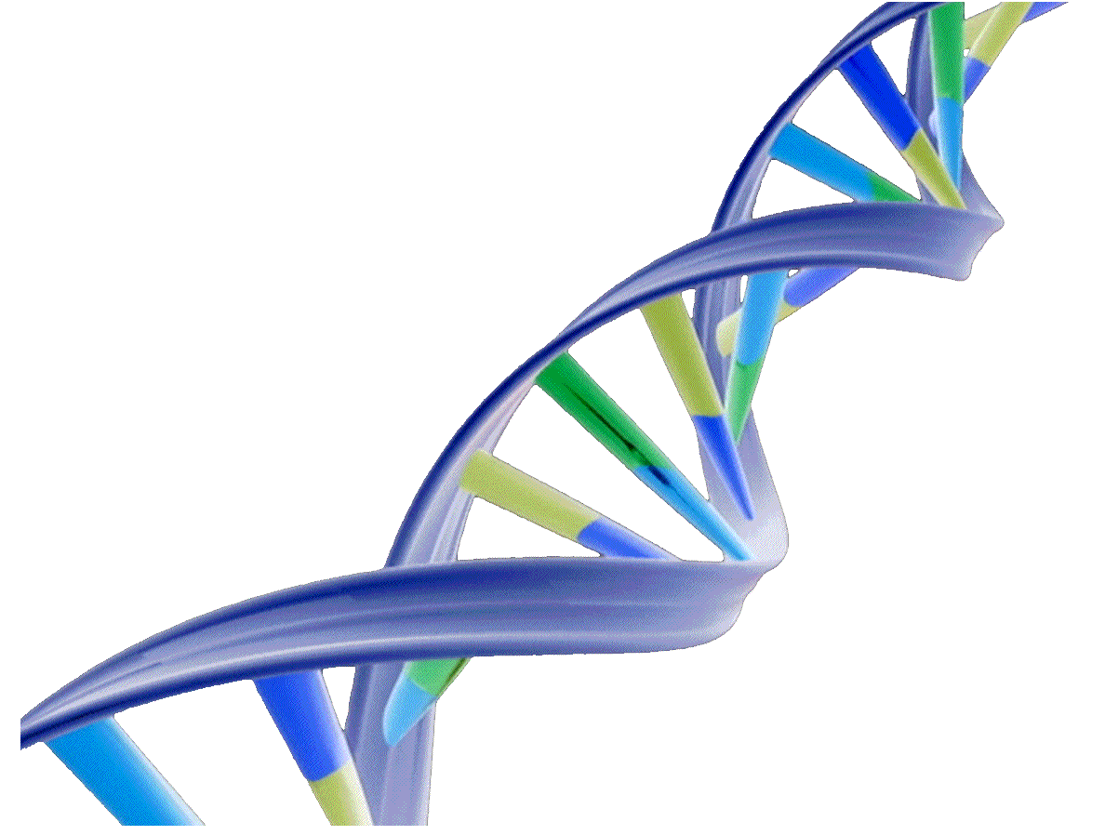
De novo genome project workflow
Extract DNA (and RNA)
Choose best sequence technology for the project
Sequencing
Quality assessment and other pre-assembly investigations
Assembly
Assembly validation
Assembly comparisons
Repeat masking?
Annotation

Slide 8
De novo genome project workflow
Extract DNA (and RNA)

Slide 9
De novo genome project workflow
Extract DNA (and RNA)
Extract much more DNA than you think you need
Also remember to extract RNA for the annotation
Single individual and haploid tissue if possible
In particular for Illumina mate-pairs data and PacBio, a lot of high molecular weight DNA is critical!
Extracting DNA for de novo assembly is very different from extractions intended for PCR
Do several extractions if possible, and run them on a gel to get an idea of how fragmented the DNA is
Try to remove contaminants from the extractions

Slide 10

Causes of DNA degradation
Experimental
setup
Sample prep
By Olga Vinnere Pettersson
Uppsala Genome Center, SciLifeLab
Mechanical damage during tissue homogenization.
Wrong pH and ionic strength of extraction buffer.
Incomplete removal / contamination with nucleases.
Phenol: too old, or inappropriately buffered (pH 7.8 – 8.0); incomplete removal.
Wrong pH of DNA solvent (acidic water).
Recommended: 1:10 TE for short-term storage, or 1xTE for long-term storage.
Vigorous pipetting (wide-bore pipet tips).
Vortexing of DNA in high concentrations.
Too many freeze-thaw cycles (we tested 5, still Ok).
Debatable: sequence-dependent

Slide 11
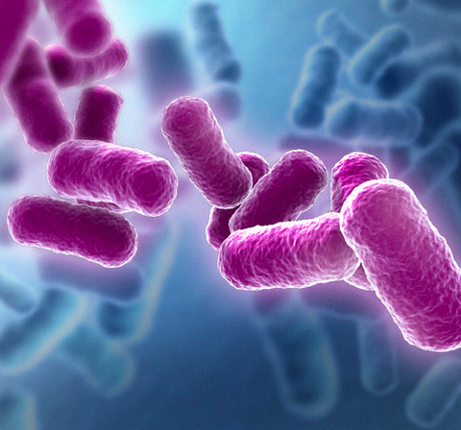
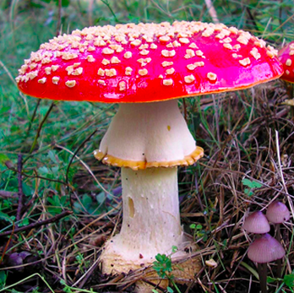
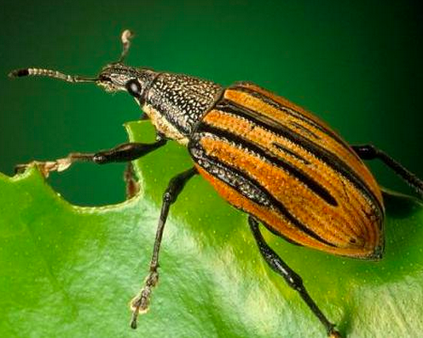

What are the main contaminants?
Polysaccharides
Lypopolysaccharides
Growth media residuals
Chitin
Protein
Secondary metabolites
Pigments
Growth media residuals
Chitin
Fats
Proteins
Pigments
Polyphenols
Polysaccharides
Secondary metabolites
Pigments
By Olga Vinnere Pettersson, Uppsala Genome Center, SciLifeLab

Slide 12
What do absorption ratios tell us?
Pure DNA 260/280: 1.8 – 2.0
< 1.8:
Too little DNA compared to other components of the solution; presence of organic contaminants: proteins and phenol; glycogen - absorb at 280 nm.
> 2.0:
High share of RNA.
Pure DNA 260/230: 2.0 – 2.2
<2.0:
Salt contamination, humic acids, peptides, aromatic compounds, polyphenols, urea, guanidine, thiocyanates (latter three are common kit components) – absorb at 230 nm.
>2.2:
High share of RNA, very high share of phenol, high turbidity, dirty instrument, wrong blank.
Photometrically active contaminants:
phenol, polyphenols, EDTA, thiocyanate, protein,
RNA, nucleotides (fragments below 5 bp)
By Olga Vinnere Pettersson, Uppsala Genome Center, SciLifeLab

Slide 13
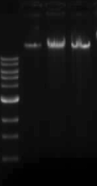
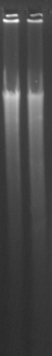
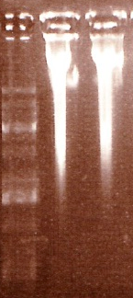
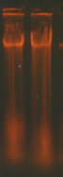
DNA quality
requirements
Experimental
setup
Sample prep
By Olga Vinnere Pettersson
Uppsala Genome Center, SciLifeLab
Some DNA left in the well
Sharp band of 20+kb
No sign of proteins
No smear of degraded DNA
No sign of RNA
NanoDrop:
260/280 = 1.8 – 2.0
260/230 = 2.0 – 2.2
Qubit or Picogreen:
10 kb insert libraries: 3-5 ug
20 kb insert libraries: 10-20 ug

Slide 14
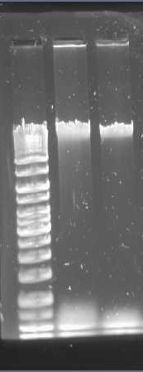
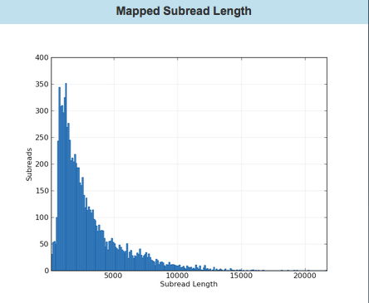
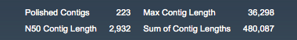
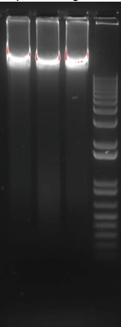
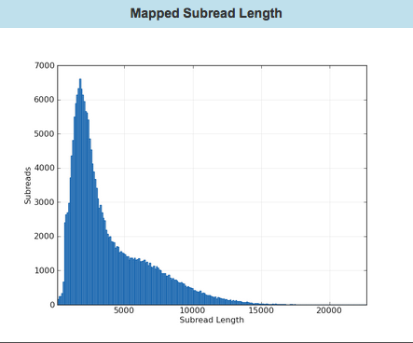
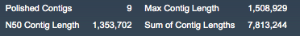
Experimental
setup
Sample prep
By Olga Vinnere Pettersson
Uppsala Genome Center, SciLifeLab
Example:

Slide 15
Some general concepts
Assembly process
Paired end/mate pair
Insert size
File formats
Contigs/scaffolds
N50

Slide 16
Next Generation Sequencing
Genomic DNA is fragmented (not Nanopore) and sequenced -> millions of small sequences (reads) from random parts of the genome
Depending on sequence technology, reads can be from 100 bp up to 100kb in length

Slide 17
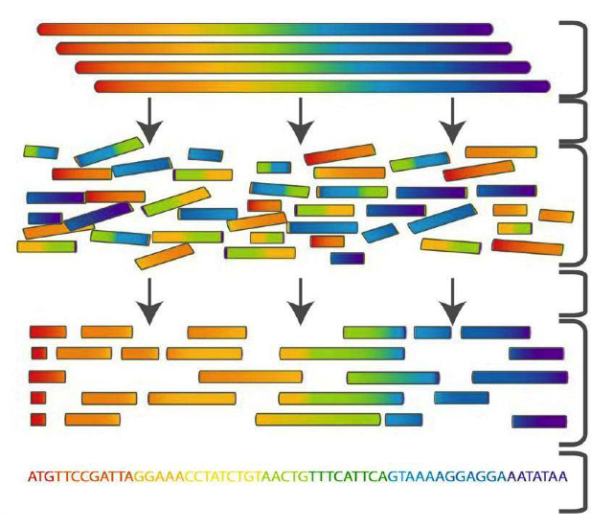
De novo assembly process
Genomic DNA
Fragmentation + Sequencing
Sequence reads
Assembly
Connection between reads
found
Consensus sequence
Modified from “De Novo Genome asssembly” PDF by Torsten Seeman, Melbourne University.

Slide 18
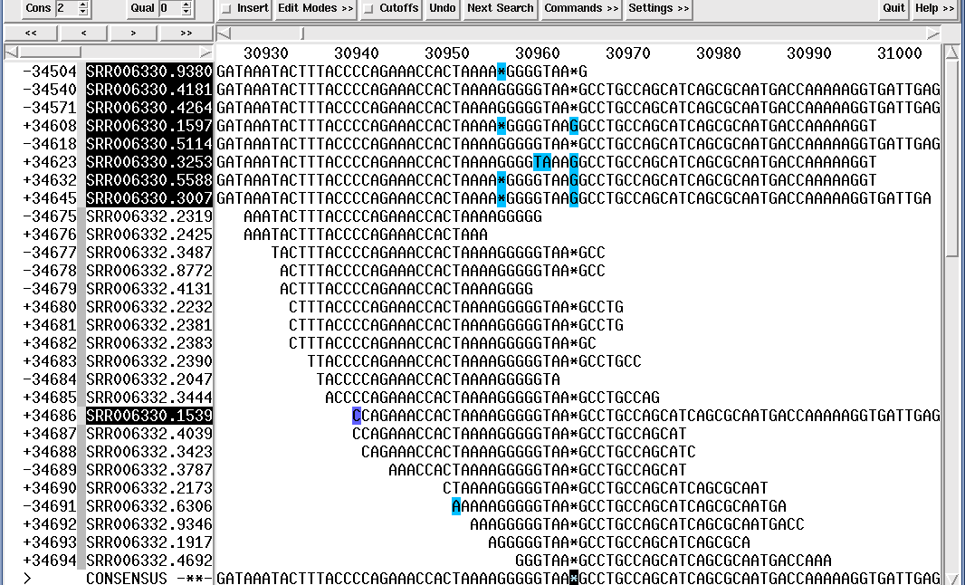
.ace file of assembly

Slide 19
Insert size
Insert size
Read 1
DNA-fragment
Read 2
Adapter+primer
Inner mate distance

Slide 20
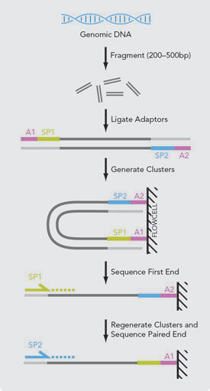
Paired-End

Slide 21
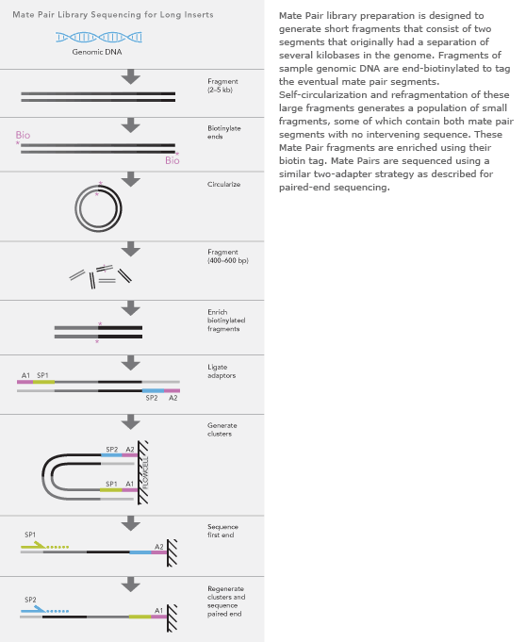
Mate-pair
Used to get long
Insert-sizes

Slide 22
Orientation of paired reads
Paired end (PE) reads
Mate pair (MP) reads

Slide 23
Fastq format
@D00118:257:C8672ANXX:2:2302:2055:2109 1:N:0:GAGATTCC+GTACTGAC
CGTAGCCCTGTGCGACGGTGTCCGACTGCACGTCGCCGTCGTAGTTCTTGCACGCCCAGACGTAACCGCCTTCCC
+
3:>@BGGGGGGGGGGGGGGGGGGGGGGGGGGGGGGGGGGGGGGGGGECGGFGGGGGGGGGGGGGGGGGG
The names follow this format:
@<instrument>:<run number>:<flowcell ID>:<lane>:<tile>:<x-pos>:<y-pos> <read>:<is filtered>:<control number>:<index sequence>
Quality values in increasing order:
!"#$%&'()*+,-./0123456789:;<=>?@ABCDEFGHIJKLMNOPQRSTUVWXYZ[\]^_`abcdefghijklmnopqrstuvwxyz{|}~
You might get the data in a .sff or .bam format. Fastq-reads are easy to extract from both of these binary (compressed) formats!

Slide 24
Fastq format - paired reads
First file:
@D00118:257:C8672ANXX:2:2302:2055:2109 1:N:0:GAGATTCC+GTACTGAC
CGTAGCCCTGTGCGACGGTGTCCGACTGCACGTCGCCGTCGTAGTTCTTGCACGCCCAGACGTAACCGCCTTCCC
+
3:>@BGGGGGGGGGGGGGGGGGGGGGGGGGGGGGGGGGGGGGGGGGECGGFGGGGGGGGGGGGGGGGGG
Second file:
@D00118:257:C8672ANXX:2:2302:2055:2109 2:N:0:GAGATTCC+GTACTGAC
GCGCATTGTCGCCTATGACCCGAACCTGAGCCCTGAGCAATGGTTCGCCTTCACCCCGCCCCGAGGACGGCGGC+
CCCCCGGGGFGGGGGGGGGGGGGGDGGGGGGGGEGGGGGGCGEGGGGGGGGGGGGGGGGGGGGFGGGGG
The names follow this format:
@<instrument>:<run number>:<flowcell ID>:<lane>:<tile>:<x-pos>:<y-pos> <read>:<is filtered>:<control number>:<index sequence>
For paired sequences (paired-end or mate-pairs) you get two files. Every read in the first file has an almost identically named “friend” read in the second file. They differ by one single number.

Slide 25
Fasta format
>asmbl_2719
AGCACCTAGAGCAGGATGGGAGGTCTCTCCTTGCTGTGGCAGAGGCAGATCTCCTTTCCC
AACACCTAGCAGTATGAACTAGTGAGCTCCTGACTGTTTTCCAGTGGTAATGAGGTGTGA
CCCGCTGCAGCTGCACACTGAATTCTCTCAGTTCCCCGAGGCCAGCCCAGCAGTGTGGGC
AATGCTTTGTTTGTGTGCTGTTGACCATTCC
>asmbl_2702
GTCTGCACTGGGAATGCCCCCTGGAGCAGAACCATTGCCATGGATAAGGACACTACATTT
CCTGGTGTTAAGGTGAATATAACCTCCAGGTTAAGGATGACATTAATTTCAATTACAGCT
TGCCTCTTGTAAGCTAAGCAGTTAATCAACAAGCTATACTGTGACTACACCCTTAGATCA
ATAGCTGGGAAAACATCACCTCCCCCAAATACTCCACCTCTTAACTGCACTCTTTGAAAG
AAGTACAGGCCAGAGTTTAGCTGATCCATCCCTGTGGCTAATCGTCCTGCTTACAAGCTG
CAATATTTTTTAAAACCAGACAATTGGTAGAGGTTTAAACATCAGCCAAGCTGTTCAATT
TACAGCAGGTTAAGCATTCCTGAAACTGTGATCACTGATATATTTGGGTCAGTCAGATGT
CTTGTTAGTGCTT
>asmbl_2701
ACAAACAAAACAAAATAAAACAAAGGAAACAAGCAAAAAAAACCATCATACAATCCCATG
TGTCCAAGAGCTTTACTGTGAAATCAACTATGGAGTCAAAACAATAGAAAAGCTTCCAGA
TTTCTGTATTCCAGGCTGAGACAAGTTTGTAAATACTTCCAGAAATTGCCAACAAGCCTG
CAGGGTAACATCTCTAATGCACACCTCCCTGATACGAAATGCAGAGCACCTTAACTTCTT
CAGCCCTCCCCCAGTCACAACCAGCTATAAATCCTGCCCTTCACTTGTTGGAATATCTCA
TCATAAGGGAAGCATTTTTTAGGCTGAGAAATACAAATCCACCTTGACGGAGCCGGTCAG
GCATATACATGGGCTATGCTGCTGATAGGTTTGTACCAAGCACTCCTAGTGTGAGAATAA

Slide 26
Contigs and scaffolds
Contig = a contiguous stretch of nucleotides resulting from the assembly of several reads
Scaffold = several contigs stitched together with NNNs in between
Paired reads
NNN
NNN
contig1
contig2
contig3
NNN
NNN
scaffold1

Slide 27
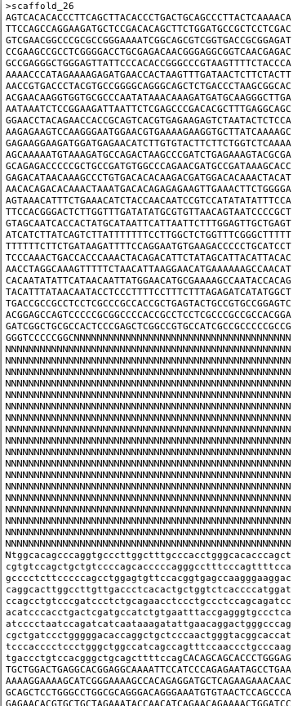
A scaffold in fasta-format

Slide 28
N50 - a measure of contiguity (at best)
N50 = contigs of this size or larger include 50 % of the assembly
>contig1
TTTATGTCCGTAGCATGTAGACATATGGCA 30 bp 30
>contig2
AGTCTTGAGCCGAATTCGTG 20 bp 30+20=50 (>45)
>contig3
GTTGGAGCTATTCAGCGTAC 20 bp
>contig4
ACAAATGATC 10 bp
>contig5
CGCTTCGAAC 10 bp
90 bp total
50% of total = 45
L50 = number of contigs that include 50% if the assembly. Here, L50=2!
N50=20!

Slide 29
NG50 - compared with genome size rather than assembly size
N50 - contigs of this size or larger include 50 % of the assembly
NG50 - contigs of this size or larger include 50 % of the genome
NG50 is a better approximation of assembly quality, but can sometimes not be calculated, e.g., the genome size is unknown
Can be quite different from N50, e.g., genome is 1,5 Gb but assembly is 1 Gb due to non-assembled repeats

Slide 30
De Novo Genome Assembly – Sequence technologies
Henrik Lantz - NBIS/SciLifeLab/Uppsala University

Slide 31
NGS Sequence technologies
Deprecated
454
Solid
Supported, not used much in genome assembly
Ion Torrent (Ion PGM)
Ion Proton
Current workhorses
Illumina
Pacific biosciences
Oxford Nanopore

Slide 32
Supporting technologies
HiC
BioNano (Irys system)
10x genomics - Chromium

Slide 33
Sequencing technology comparison
Sequencing system | Read length | Yield
Illumina Hi-Seq 2500 | 2x125 bp | 180 M read pairs/lane, 28 Gbp/lane
Illumina HiSeqX | 2x150 bp | 350 M read pairs/lane, 78Gbp/lane
Illumina MiSeq | Up to 2x500 bp | 18 M read pairs/lane, 7.4Gbp/run
PacBio RSII | 250-70000 bp | 1 Gb/SMRTcell
PacBio Sequel | 250-80000 bp | ~6 Gb/SMRTcell
Oxford Nanopore | 500-900000 bp | 16? Gb

Slide 34
Error rates and types
Sequencing system | Error type | Error rate
Illumina | Substitutions | 0.1%
PacBio | Insertions | 0.001-12% depending on read length
Oxford Nanopore | Substitutions, indels | 15%

Slide 35
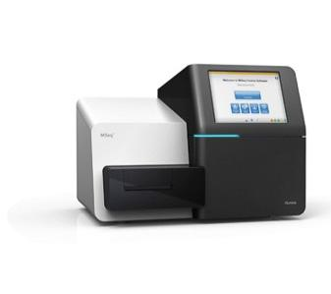
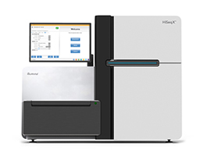
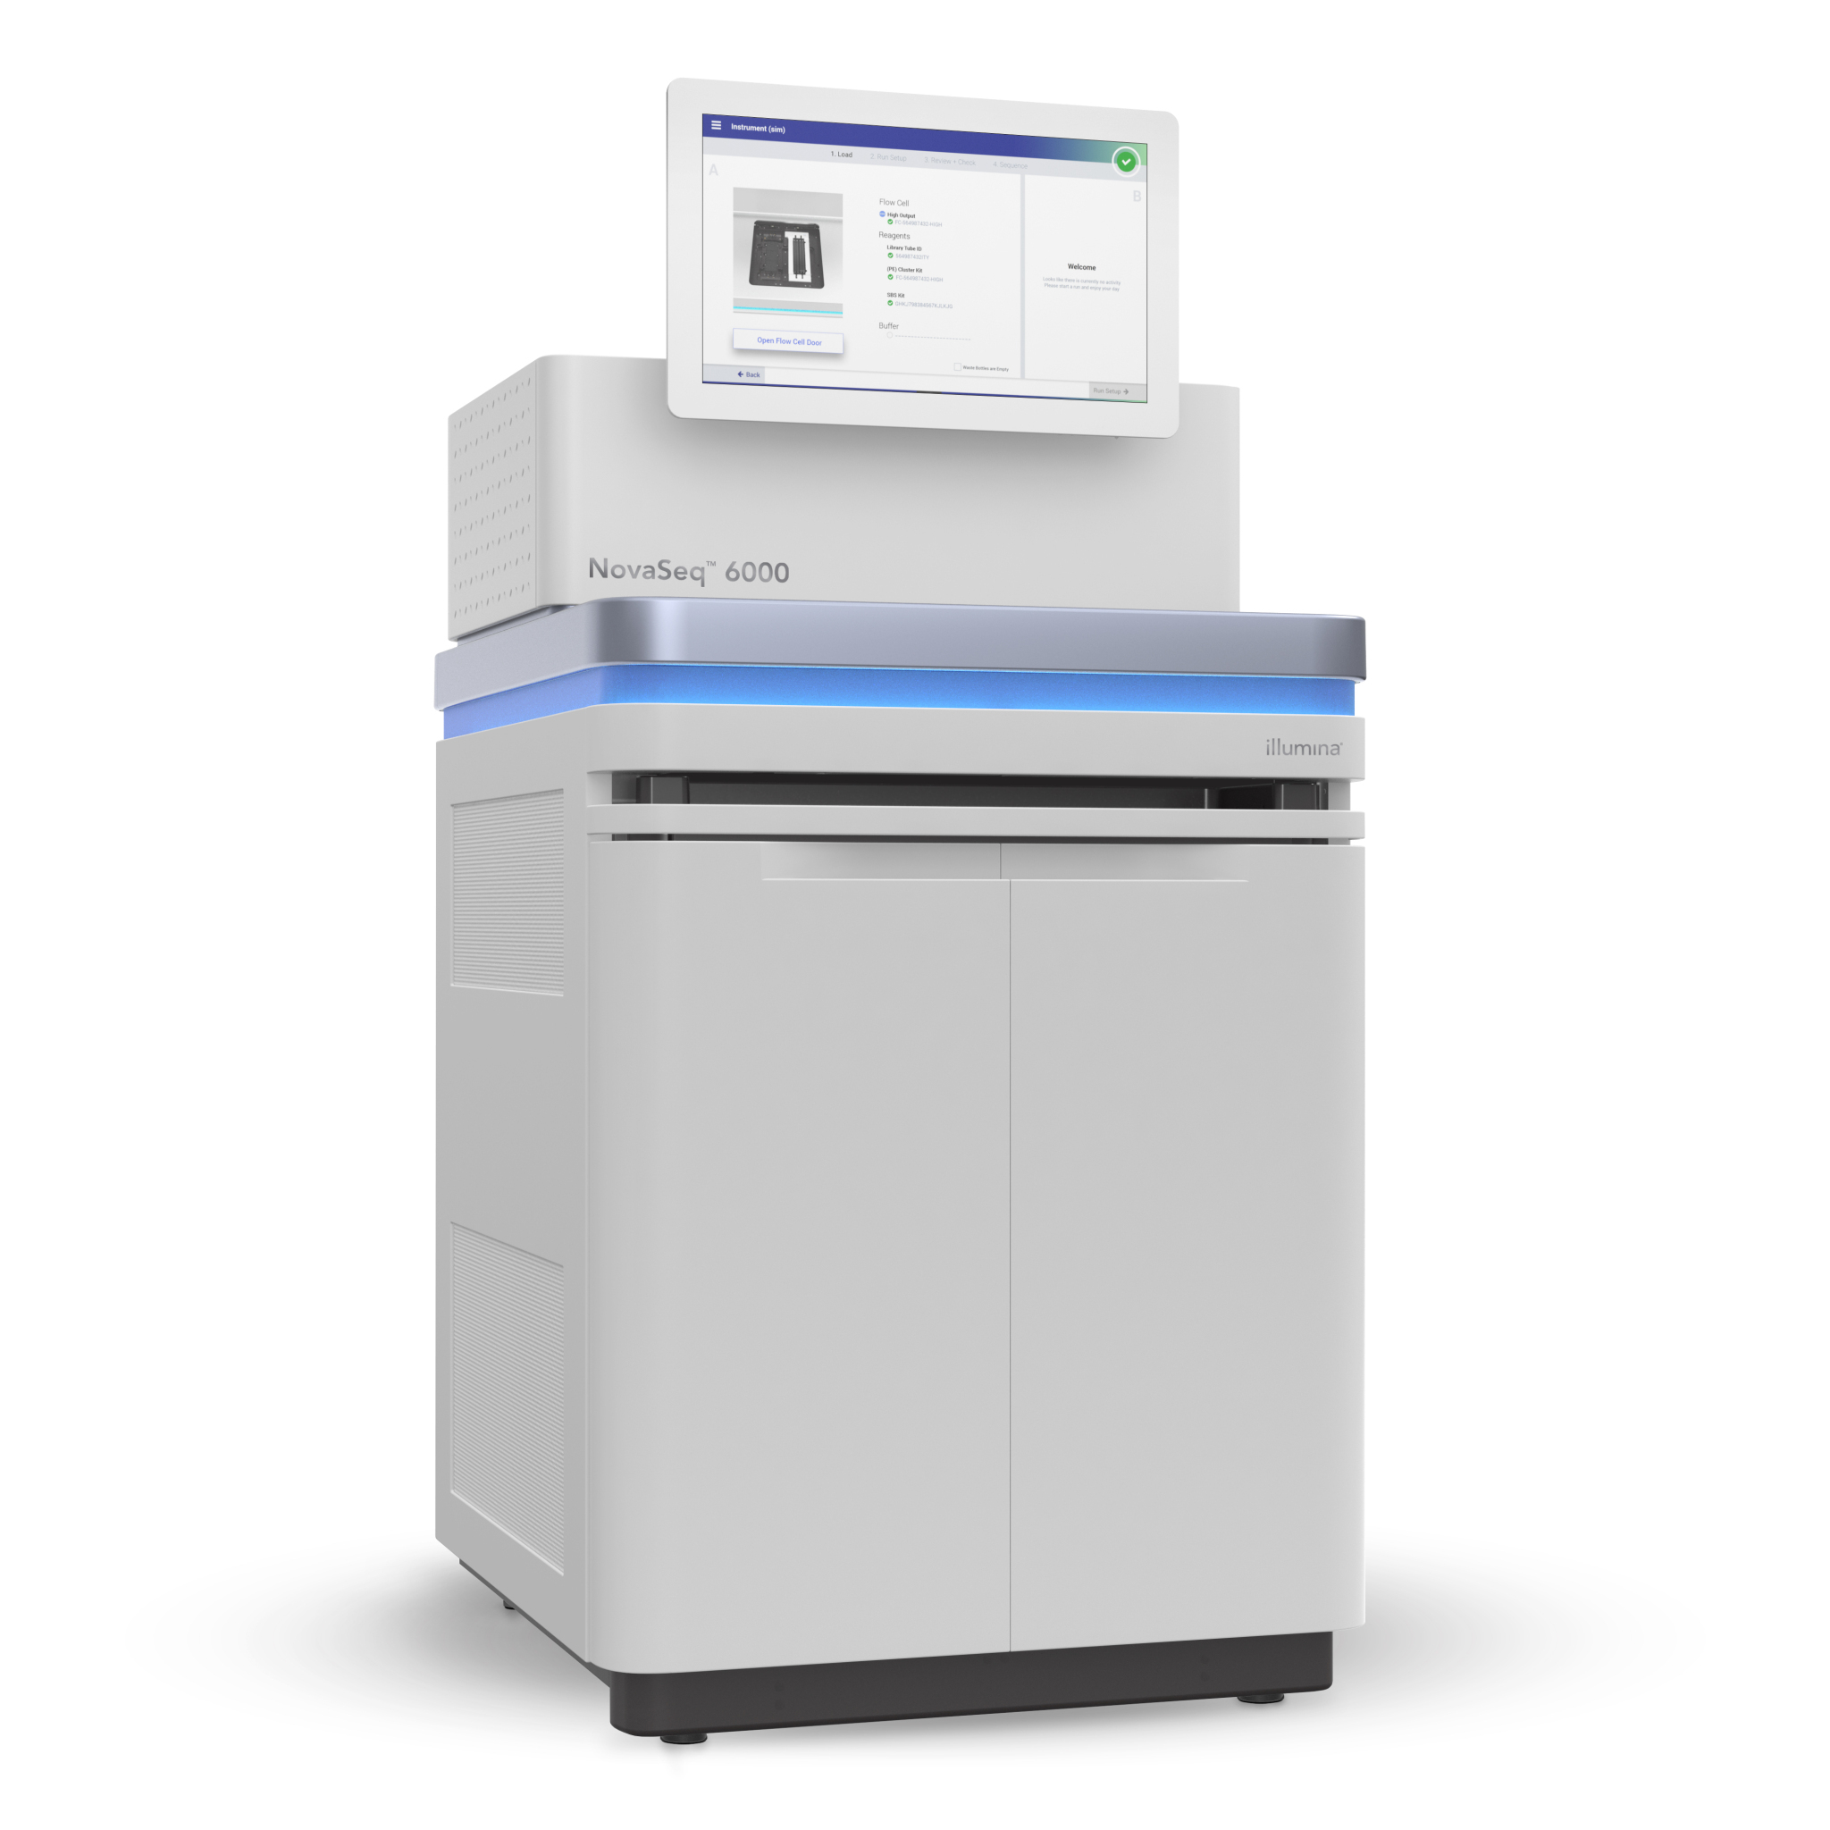
Illumina technology
MiSeq
Hiseq
NovaSeq

Slide 36
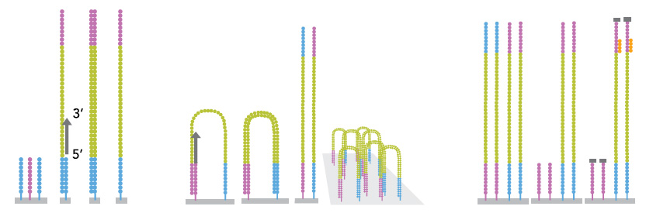
Illumina
Pros: Huge yield, cheap, reliable, read length “long enough” (100-300 bp), industry standard=huge amount of available software
Cons: GC-problems, quality-dip at end of reads, long running time for Hi-Seq, short insert-sizes

Slide 37
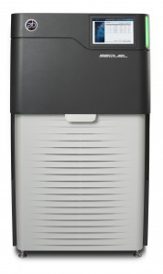
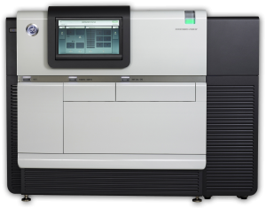
PacBio technology
RS II
Sequel

Slide 38
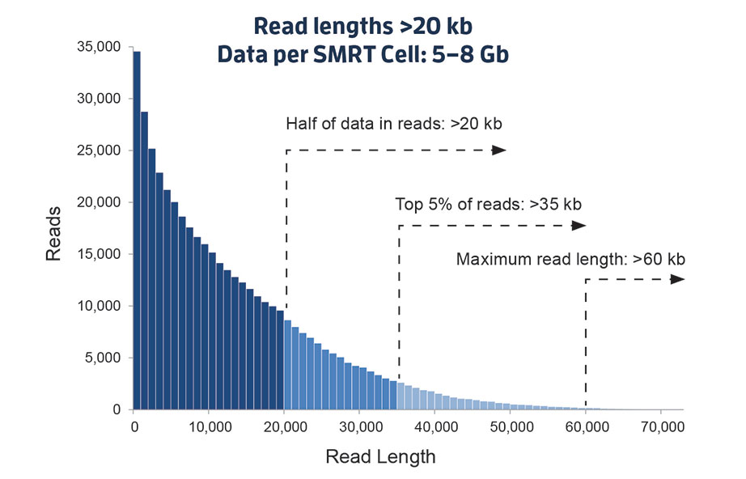
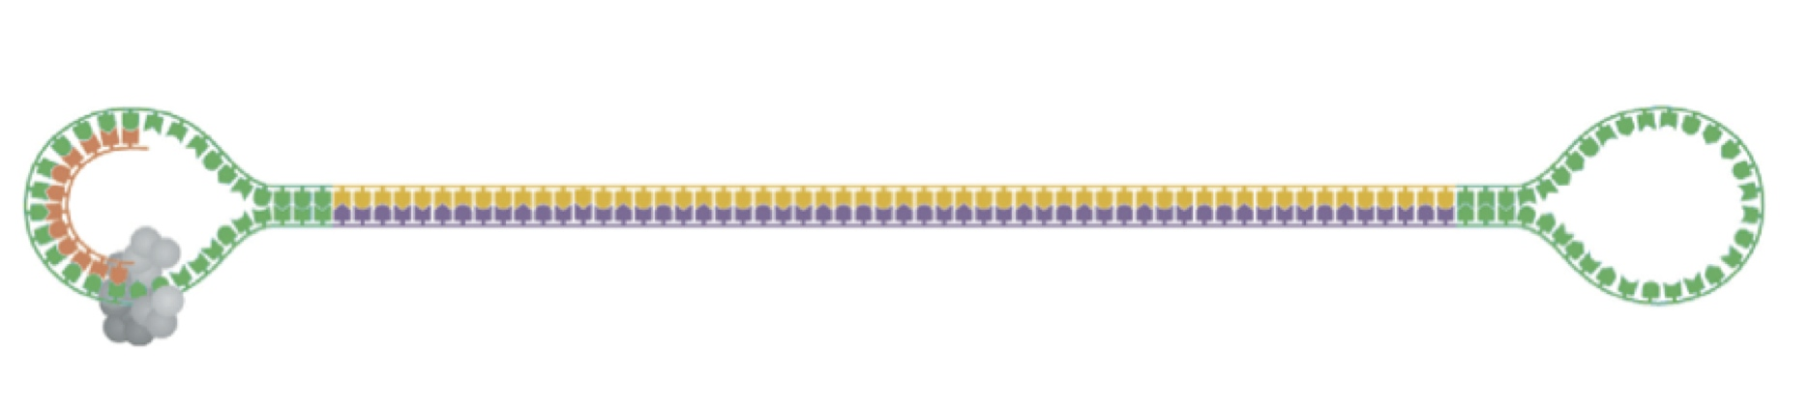
Pacific Biosciences
Pros: Long reads (up to 80k), single molecules
Cons: High error rate on longer fragments (15%), expensive

Slide 39
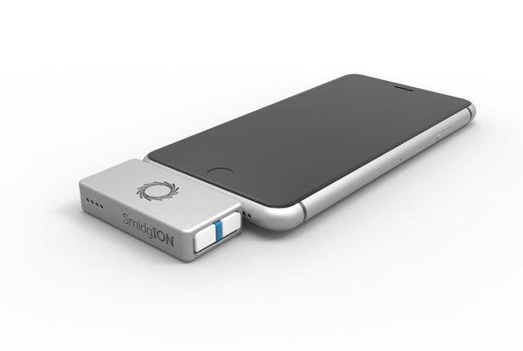
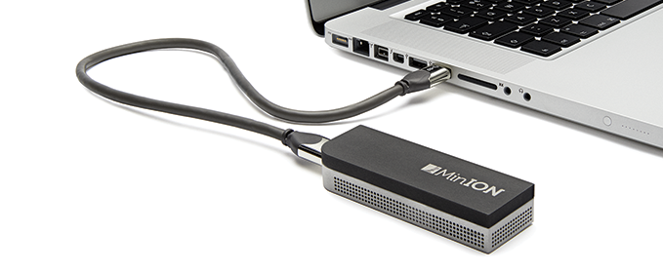
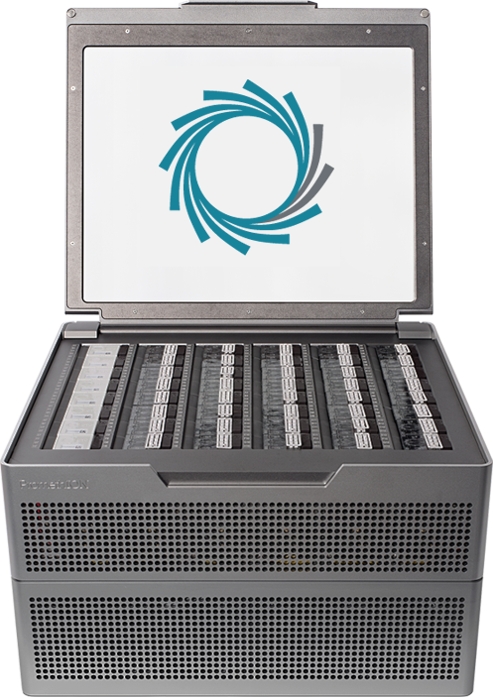
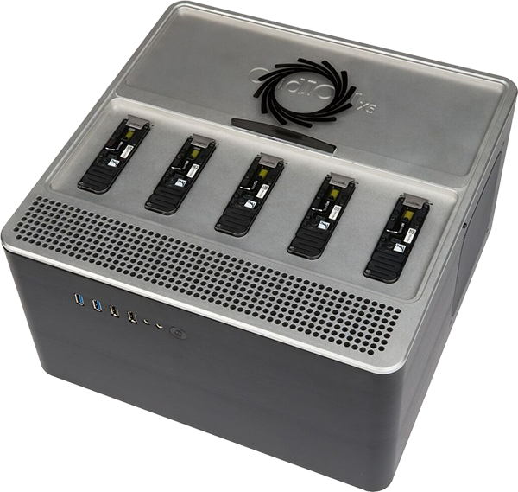
Nanopore technology
SmidgION
MinION
GridION
PromethION

Slide 40
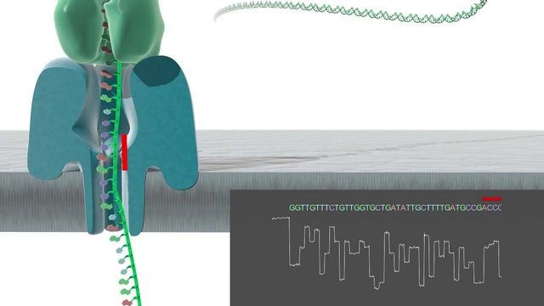
Nanopore
Pros: Extremely long sequences, single molecule, portable (minION)
Cons: High error rates (15 % usually)

Slide 41
Supporting technologies - scaffolding
10x genomics – Chromium
Long – up to 80 KB, at least
BioNano (Irys system)
Looong – 1 MB
HiC
Chromosome length – 500 MB

Slide 42
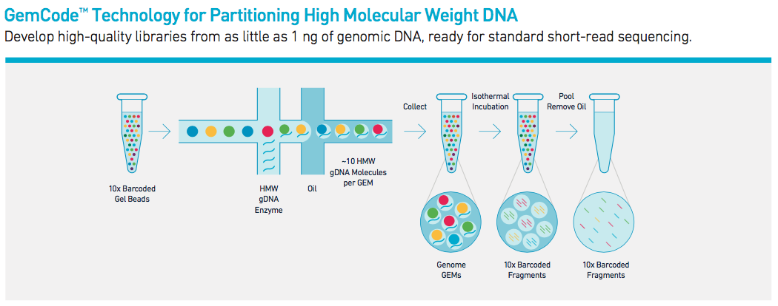

10x genomics
Long DNA fragments are separated in gel beads (gems) and then sequenced with Illumina HiSeq -> linked reads originating from the same (long) DNA fragment

Slide 43
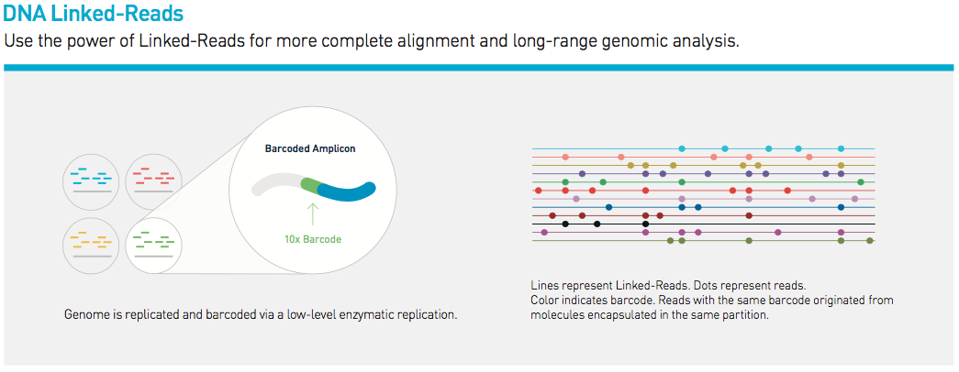
Linked reads
These reads can then be used to assemble the genome (Supernova) or scaffold/phase the genome (ARCS)

Slide 44
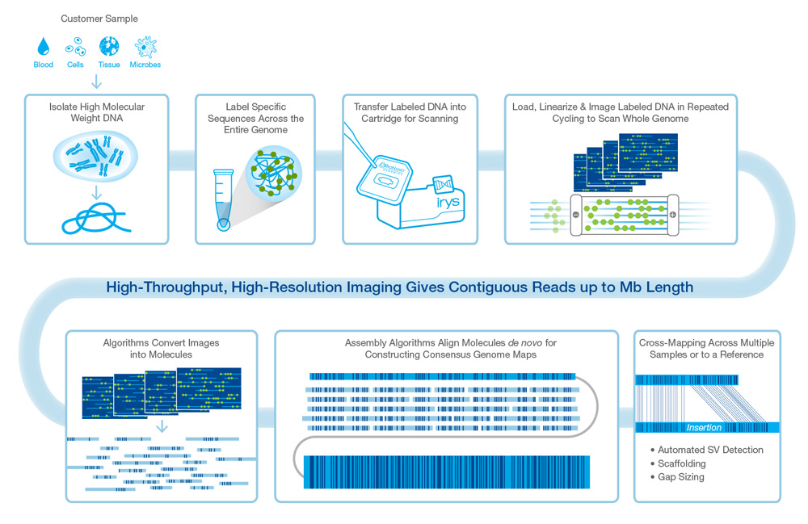
BioNano

Slide 45
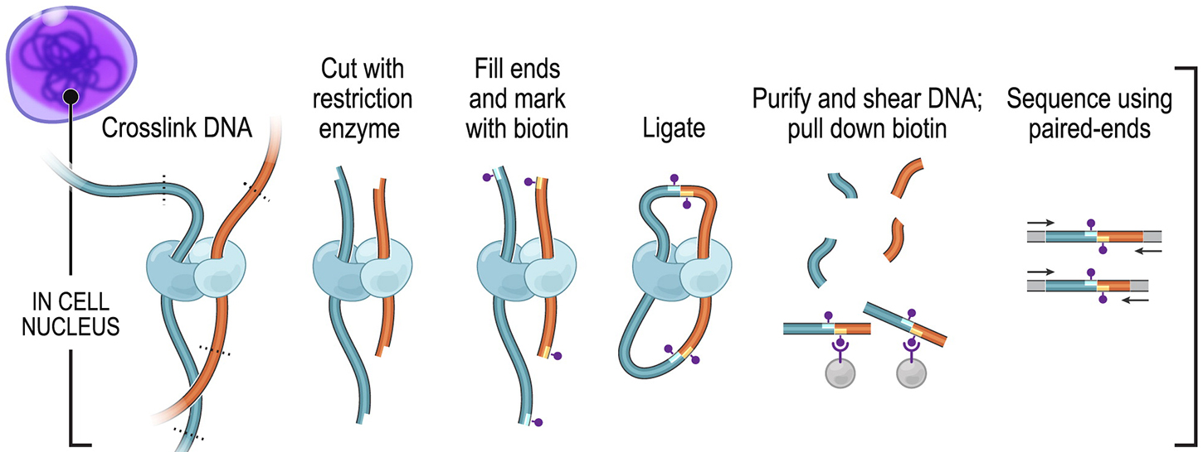
Hi-C
Reads can be distanced up to 500 MB
Adapted from Rao et al., 2014. Cell 159: 1665-1680.

Slide 46
You need help?
NBIS is offers bioinformatics support to all projects in Sweden. Please go to http://nbis.se/support/supportform/index.php to apply for support.

